Slide 1




Integrating Ethics Across the Curriculum: A Hands-On Workshop October 23, 2009 UMET - Cupey
by J. Cruz, A. Curbelo, and W. Frey
University of Puerto Rico at Mayagüez
Sponsored by NSF SES Grant # 0551779

Slide 2
Workshop Objectives
Introduce Ethics Across the Curriculum
Explain and model various EAC interventions
Give you the opportunity to develop your own student modules in ethics
Describe how you can publish and share your modules via the EAC Toolkit
Invite you to be part of an interdisciplinary community committed to EAC

Slide 3
Workshop Agenda Highlights
EAC Education Survey
Introduction to EAC
Demonstrations
EAC “Pre-Test” / Gray Matters / Digital Images
Ideas and Resources for EAC Modules
Hands on
Create Modules
Present Modules
The EAC Community & the EAC Toolkit
Action Plan: Implementation and Assessment
Evaluation and Certificates

Slide 4
Ethics Education Survey : Group Discussion
William J. Frey, José A. Cruz & Aury M. Curbelo College of Business Administration
UPRM

Slide 5
Ethics Education Survey
Does your program cover ethics or practical and professional ethics in your curriculum?
What are the main reasons you and your program have for incorporating (or for not incorporating) ethics into the curriculum?
Does your program currently offer courses in ethics or practical and professional ethics?
Does your program carry out activities other than a course to introduce ethics into your curriculum?
Do you or your program require additional support (resources, materials, etc.) for incorporating ethics content in your curriculum or for improving the ethics content already in your curriculum?
What other concerns regarding ethics education do you have?
Identify and rank three to five ethical issues relevant to your area of teaching or research.

Slide 6
Ethics Across the Curriculum
William J. Frey College of Business Administration
UPRM

Slide 7
What is EAC?
Ethics Across the Curriculum
An approach to teaching ethics that complements stand-alone courses in ethics with “mirco-interventions” in mainstream courses in agriculture, business, education, engineering, nursing, sciences, etc.
Students see, through their curricular experience, how ethics is integrated throughout everyday life

Slide 8
EAC: A Hybrid Holistic Approach
EAC
Stand Alone Course
Special Activities (e.g. Ethics Bowl)
EAC Resources (cases, exercises, modules, etc.)
Faculty Development Workshops
Micro- interventions
Interrelated activities to place ethics into and across the curriculum

Slide 9
What are EAC’s Advantages?
Reflects the integration of ethics throughout real life
Provides students and faculty with a sense of ownership to secure “buy-in”
Interdisciplinary approach helps faculty and students form a community
Gives ethics a context to avoid theory-practice gap
Brings ethics into the center of the curriculum
Builds upon expertise of interdisciplinary faculty

Slide 10
Challenges to EAC
Documenting ethics micro-interventions
You probably do not even realize all the things you are doing that can also be described as ethics micro-interventions
Finding time and curricular space …
in my classes
in our curriculum
Be creative
Being comfortable with your competence/expertise
Skills in ethics self-defense does not require a Black Belt in Ethics

Slide 11
Sample Modules
EAC “Pre-Test”
José A. Cruz
Gray Matters
William J. Frey
Digital Images
Aury M. Curbelo

Slide 12
Ethics Across the Curriculum: A Module for Introduction to Computers
José A. Cruz-Cruz
College of Business Administration
UPRM

Slide 13
My Goal
Share and demonstrate a useful and efficient ethics integration exercise that I use in my class.

Slide 14
Ethics-Related Scenarios
For each scenario briefly react to the following three questions, for example:
An employee uses his/her computer at work to communicate with friends and relatives.
1. Do you think this situation is Common/Realistic?
Yes or No
2. Do you consider this situation Ethical or not?
Ethical or Unethical
3. Do you think someone may disagree with you?
Yes or No

Slide 15
Typical Student Comments
“I don’t want to be treated as a slave or robot.”
“These people get paid well to work.”
“Some work hard, while others surf the Internet?”
“As long as my boss doesn’t see me …”
“I minimize the browser …”
“Maybe someone opens an e-mail with a virus …”
“Maybe the person doesn’t have a PC at home?”
“Isn’t this similar to using the phone to call a friend?”
“Everybody does it!”

Slide 16
Closure versus Chaos
The 3 Ethical Decision Making Tests‡
Reversibility
Publicity
Harm
‡ Michael Davis (1999) Ethics and the University. New York, NY: Routledge

Slide 17
REVERSIBILITY
Would I think this a good choice were I among those affected by it?
“Put yourself into the other person’s shoes”
Students bring up this issue, for example:
“I’m not a slave/robot” … employee perspective
“I pay these people well” … employer perspective
“I work hard, others surf?” … colleague perspective

Slide 18
PUBLICITY
Would I want or mind if this choice is published in the newspaper?
“Ojos que no ven, corazón que no siente”
What does this action say about me?
Students also bring up this issue, for ex.:
… early in the morning before the boss arrives
… I toggle between e-mail & the work I’m doing

Slide 19
HARM
Does the action cause harm? Are there less harmful alternatives?
“El remedio es peor que la enfermedad”
“The remedy is worst than the illness”
Students bring up this issue, for example:
It can interfere / affect with other people’s work.
Unfair, some take advantage … others don’t!
They could ban the use of e-mail and Internet?

Slide 20
Scenarios Revisited
Students re-evaluate the scenarios using the 3 tests
it changes their perception of the situation
it focuses them towards solutions.
For example regarding the e-mail scenario students have suggested the following solutions:
Promote awareness of Institutional Policy or Guidelines
Provide Training and Helpdesk

Slide 21
Why is Ethics Important?
Awareness of ethics can improve our assessment of a situation.
If we incorporate ethical considerations early in the decision-making process we can avoid difficult ethical choices later on.
“It’s everybody's responsibility.” †
†Ernest A. Kallman and John P. Grillo, Ethical Decision Making and Information Technology, 2nd ed., New York: McGraw-Hill, 1996. (p. 19)

Slide 22
Where to go from here?
Take a course in Engineering or Business Ethics
Study Professional & Corporate Codes of Conduct
Seek and read ethics-related articles
Take the time to read ethics related chapters and excerpts available in many textbooks
Discuss ethical issues with your colleagues & friends
Internet Sites ( www.onlineethics.org & many others )

Slide 23
The Gray Matters Exercise
William J. Frey College of Business Administration
UPRM

Slide 24
The Gray Matters Exercise
A scenario followed by a series of possible solutions
Lockheed/Martin training program
Goal—Acquaint employees with company policy concerning common ethical problems

Slide 25
Instructions for Gray Matters
Read the scenario and solutions.
Choose from the solutions offered the one you think is the best and the one you think is the worst
Using the ethics tests, explain why these solutions are your choices for best and worst.
What would you do in this situation? Why?
Feel free to design your own solution.
Notes:
Simon (quoted by Pinkus et al): “in the decision making situations of real life, a course of action, to be acceptable, must satisfy a whole set of requirements, or constraints.” 82

Slide 26
Pacemaker Case
A pacemaker manufacturing company (PACE Inc.) located in a small town in Puerto Rico provides jobs to about 80% of the town’s workforce. Profit margins are thin in this competitive field which includes larger U.S. companies. You are on an R&D team for PACE that has studied two options for the circuitry: BULK CMOS and SOI. The team favors BULK CMOS because the manufacturing process is simpler and cheaper. But the chips will be larger and consume more energy; this means more surgery for the patients to replace the batteries. Overall, the use of BULK CMOS might reduce patient life expectancy; some persons have estimated this as high as 15%. Given this knowledge, what should you do?

Slide 27
Alternatives: Pacemaker Case
Go along with the team and advocate the simpler and cheaper process.
Oppose the team and advocate the more complex, more expensive, but safer process. Try to persuade the team members to opt for safety.
Oppose the team. Force agreement by threatening to blow the whistle.
Resign from PACE, Inc.
Design your own solution.

Slide 28
Developing Gray Matters type exercise
Formulate your scenario
design it from the participant perspective (around a decision point or points)
sources (real life experiences, textbooks, newspaper articles, movies, novels, etc.)
idealize and generalize
Construct solutions
Possible starting point - four generic options:
(1) give in
(2) negotiate
(3) oppose
(4) resign

Slide 29
Digital Manipulation
Aury M. Curbelo
College of Business Administration
UPRM

Slide 30
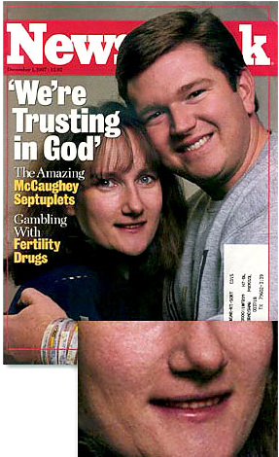

Aury M. Curbelo Ph.D University of Puerto Rico Mayagüez Campus
Photo Editing Code of Ethics
Picture source: http://www.cnet.com.au/software/imaging/0,239035345,240092347-11s,00.htm

Slide 31
“As a result of the boom in digital photography and the availability of applications like Photoshop one of the most common philosophical and ethical discussions within the photographic community is about the appropriate use and extent of photo manipulation.” Jim Goldstein
http://www.jmg-galleries.com/blog/2007/04/17/ethics-of-photography-career-suicide-by-photoshop/

Slide 32
“While the technology may not have any ethics, the user’s ethics are now tested by the endless possibilities of what technology can do.” Natalia Fletcher
http://www.nataliafletcher.com/photo/ethics.htm

Slide 33
My intentions…
I want my students to think about the issues in digital photography and arrive at their own conclusions in a logical and reasoned manner.
I want my students to understand that photographs are no longer fixed images; images have become something you can change, therefore….
We need to change how we perceive what a photograph is.

Slide 34
My intentions…
I want to give my students…
CHOICES
ETHICAL CHOICES
Understanding the CONTEXT
“Where the photo runs makes all the difference in the world.” John Long (1999)
“Context becomes a problem when we find digitally altered photos in reputable publications” John Long (1999)

Slide 35
Student Awareness
“One way of helping students to understand the issues surrounding photo manipulation is to have them ask questions...
make them aware of all the issues involved when they create images for the school newspapers, art class, term papers and other school work.”
Bonnie Meltzer
http://www.fno.org/may97/digital.html

Slide 36
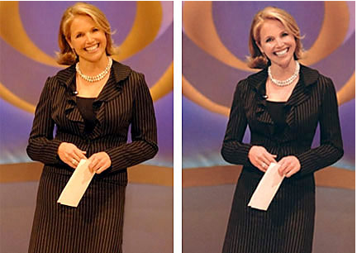
photo editing code of ethics module….
**CBS puts Katie Couric on a digital diet -- and that's just one of many recent instances of image trickery.-http://www.cnet.com.au/software/imaging/0,239035345,240092347-1s,00.htm

Slide 37
how far do you go?

Slide 38

Dove Campaign for Real Beauty
http://www.youtube.com/watch?v=iYhCn0jf46U

Slide 39
1.Should a person ever be added or subtracted from a photo? 2.What makes the difference between a positive use of photo manipulation and an abuse of it?
discussion

Slide 40
Discuss the impact of digital manipulation

Slide 41

Pyramid Scheme
Stuck with two inconveniently located Egyptian pyramids, National Geographic squeezed them together so they'd fit onto the magazine's vertical cover in 1982.
Source: Hany Farid, Dartmouth University
http://www.wired.com/gadgets/digitalcameras/multimedia/2007/03/wiredphotos54?slide=4&slideView=4

Slide 42
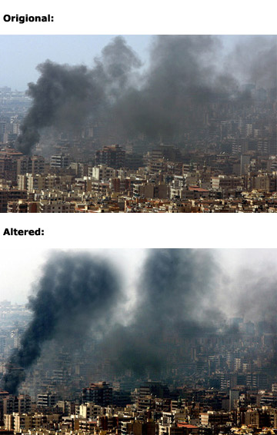
Smoke and Mirrors
In 2006, bloggers uncovered manipulation in a Reuters photo of a bombed-out Lebanese cityscape. Photographer Adnan Hajj, later fired by the news service, copied elements of billowing smoke from where it appeared in the photo to others where it did not appeared.
Notice how patterns of smoke in the manipulated photo are repeated.
The resulting scandal gave ammunition to critics who claim the media's Mideast coverage is biased.
Source: PDNonline.com
http://www.wired.com/gadgets/digitalcameras/multimedia/2007/03/wiredphotos54?slide=6&slideView=5

Slide 43

Redbook retouched Faith for this cover.
http://jezebel.com/gossip/top/heres-our-winner-redbook-shatters-our-faith-in-well-not-publishing-but-maybe-god-278919.php

Slide 44
“Detecting forged images is only half the problem though. Ultimately, the responsibility lies with the individual.”
Joel Burslem on Friday, March 9, 2007
http://www.futureofrealestatemarketing.com/the-ethics-of-photoshopping-real-estate/

Slide 45
The decision process…

Slide 46
Guidelines…
Where did I get this photo? Is it mine to use?
When can I use a copyrighted photo?
Why am I changing this photo?
How will the readers interpret this photo?
How would they have interpreted it without editing?
What is the context of the photo?
Is this photo supposed to be truth (journalism) or fantasy (art)?
http://www.fno.org/may97/digital.html

Slide 47
Guidelines…
Generally Allowed:
Brightness/contrast control
Burning & dodging to control tonal range
Color correction
Cropping a frame to fit the layout
Retouching of dust & scratches
http://wiki.wsu.edu/wsuwiki/Photo_manipulation_ethics

Slide 48
Guidelines…
Never Allowed:
Adding, moving, or removing objects within the frame
Color change other than to restore what the subject looked like
Cropping a frame in order to alter its meaning
Flopping a photograph (left/right reversal)
Printing a photograph in other than "true" orientation

Slide 49
Just because you CAN digitally retouch a photo, it doesn't mean you should.

Slide 50
Questions….
?
Aury M. Curbelo, PhD.
acurbelo@uprm.edu

Slide 51
Sources and Ideas for EAC
Books and Textbooks
“The Cheating Culture” by David Callahan
textbook exercises
Magazine articles, news, online news
Movies, TV programs, plays
The Internet
onlineethics.org, computingcases.org, niee.org, cnx.org
Personal experiences (including students’)
For more online sources, see appendix

Slide 52
Start Brainstorming with Colleagues
Next on the agenda: The fun part!
Develop EAC module ideas (individually)
Share your ideas with your group members
Select one idea and prepare an EAC Module
Groups present their EAC Modules

Slide 53

Creating EAC Modules MICRO-Interventions
Now it’s your turn…

Slide 54
What is a Module?
Modules are the building blocks of EAC
Modules are structured interventions that develop a student’s abilities to recognize and analyze ethical issues and make informed decisions by using moral reasoning
A module can be built around things such as cases, exercises, news articles, activities, etc., and may also include pedagogical information, guidelines, and strategies.

Slide 55
Creating EAC Modules
Now its your turn to create a micro-intervention
You have seen three examples
Use these as points of departure
Contextualize, contextualize, contextualize…
Integrate with your teaching
Show how ethical issues arise in the context of your field or expertise

Slide 56
Task # 1: Develop Ideas for Your module
Individually
write one or two ideas on an index card
one case / situation / concept per card
K E E P I T S I M P L E ( KISS )… build in complexity later
15 minutes
10 minutes
5 minutes
READY

Slide 57
Task # 2: Present & Discuss Ideas in Your Group
In your group
each person presents his or her idea to the other group members
20 minutes
15 minutes
10 minutes
5 minutes
READY

Slide 58
Task # 3: Select and Complete one Module
In your group
select one of the ideas and prepare a micro-interventions exercise to for presentation to the plenary
25 minutes
15 minutes
5 minutes
READY

Slide 59
Task # 4: Group Presentations
10 minutes per group
colleagues provide constructive feedback
Group 1
Group 2
Group 3
Group 4

Slide 60
EAC Community / Program: Beyond The Workshop

Slide 61
Our Experiences
An EAC Community has emerged
We’ve identified relevant ethics issues
Many products (cases, modules, interventions, etc.)
Interdisciplinary collaboration
Our colleagues have become empowered in EAC Pedagogy

Slide 62
Next Steps: Continuity is Important
Capture what was accomplished today
preserve, utilize and share the knowledge generated today
You can build an effective EAC Program on the foundation you have established today!
We want to proposed a time-tested plan

Slide 63
The Action Plan
Develop your today’s ideas (+ other ideas) into modules
“ … with a little help from your friends …”
with “brown-bags” meetings
Test your modules in class
invite a friend or colleague to observe
Learn from the classroom experience then refine
Share your modules ( learn from each other )
“Publish” (share) your modules / lesson plans online
open educational resources ( open source SW development )

Slide 64
Here’s how we can help
We will summarize today’s survey results
you verify and comment
We will inventory today’s products
you keep us informed
We will coordinate with your liaison
Name | Idea | Link
Pedro | Jóvenes, privacidad y facebook | http://....
Carlos | Conflicto de interés en salón de clases | http://....
Carmen | Uso de música e imágenes del Internet | http://....

Slide 65
Here’s how we can help
We cross-reference survey results with products
you verify and comment
 | Issue-1 | Issue-2 | Issue-3 | Issue-4 | Issue-5 | Issue-6
Mod A |  |  | √ | √
Mod B | √ |  |  |  |  | √
Mod C |  | √ |  | √
Mod D
… |  |  |  | √
Mod Z | √ |  | √

Slide 66
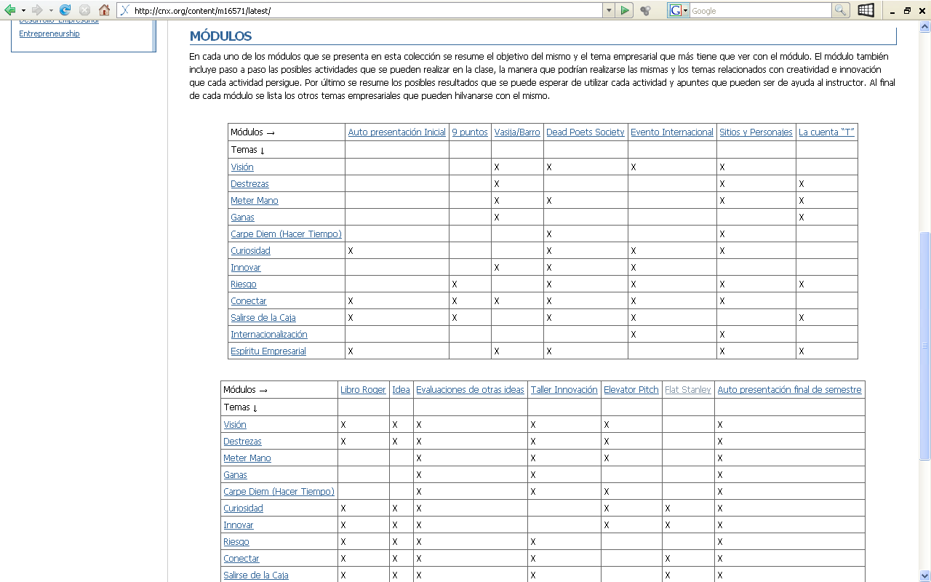
Example: “Entrepreneurship Matrix”
http://cnx.org/lenses/eactoolkit/entrepreneurship

Slide 67
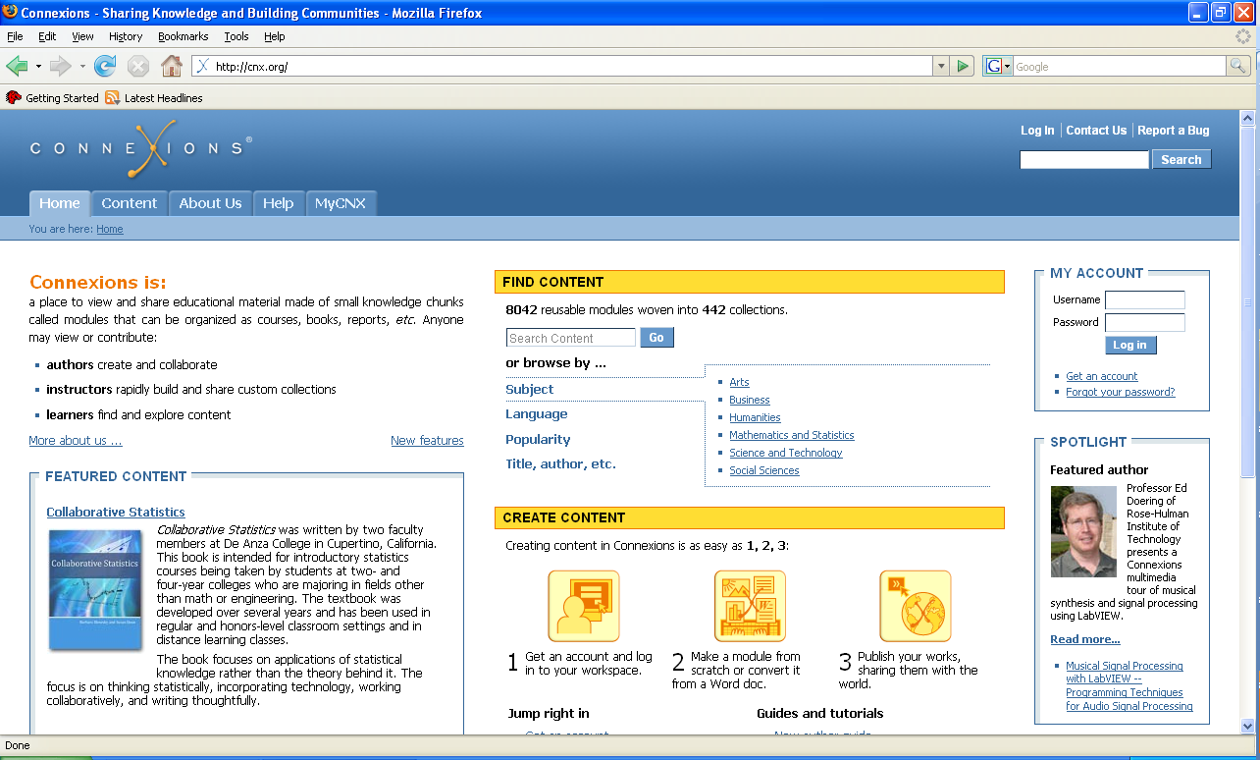
Rice University’s Connexions® platform
cnx.org is an online environment for the “open source” development and sharing of educational modules, courses and textbooks

Slide 68
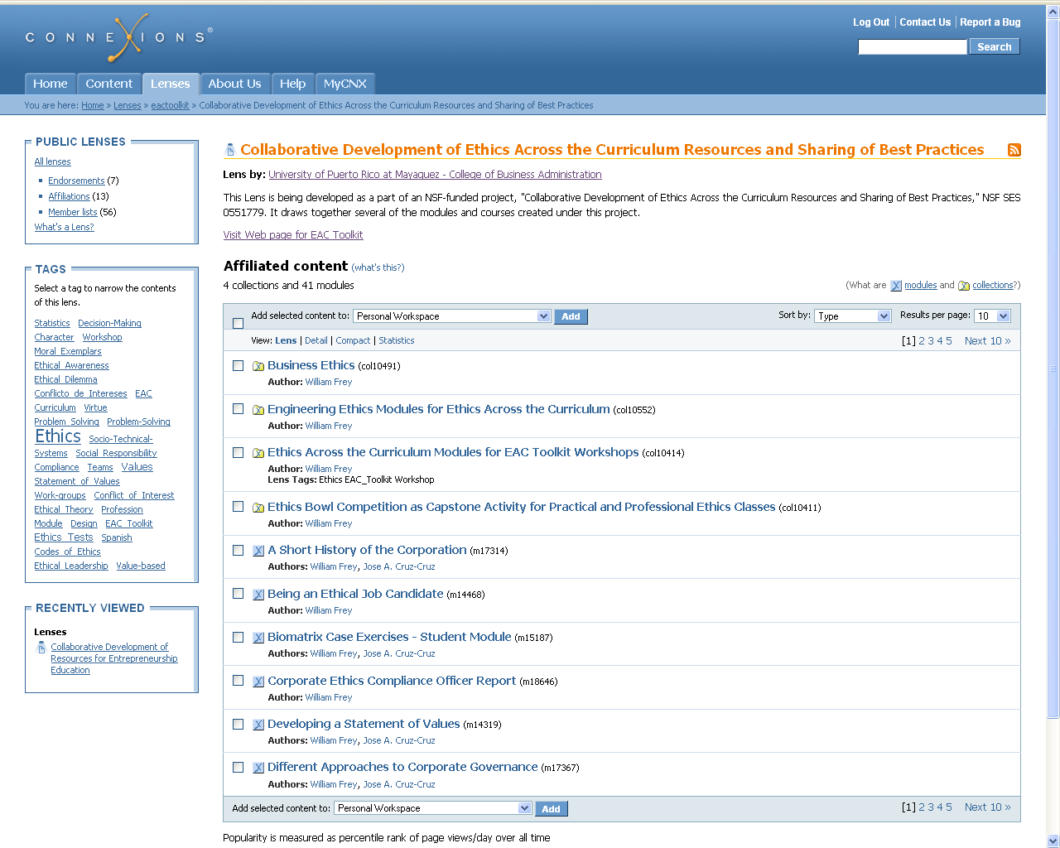
EAC Toolkit Lens @ Connexions®
http://cnx.org/lenses/eactoolkit/eactoolkit

Slide 69
The EAC Toolkit Concept – the 3 Cs
An online environment for the collaborative development of EAC resources and sharing of best practices
An intellectual commons and virtual community for EAC constituents
A means to provide continuity to workshops, meetings and conferences

Slide 70

Thank You!
Please complete the evaluation form
Contact us
cruz.jose@adem.uprm.edu
curbelo.aury@upr.edu
frey.william@adem.uprm.edu

Slide 71
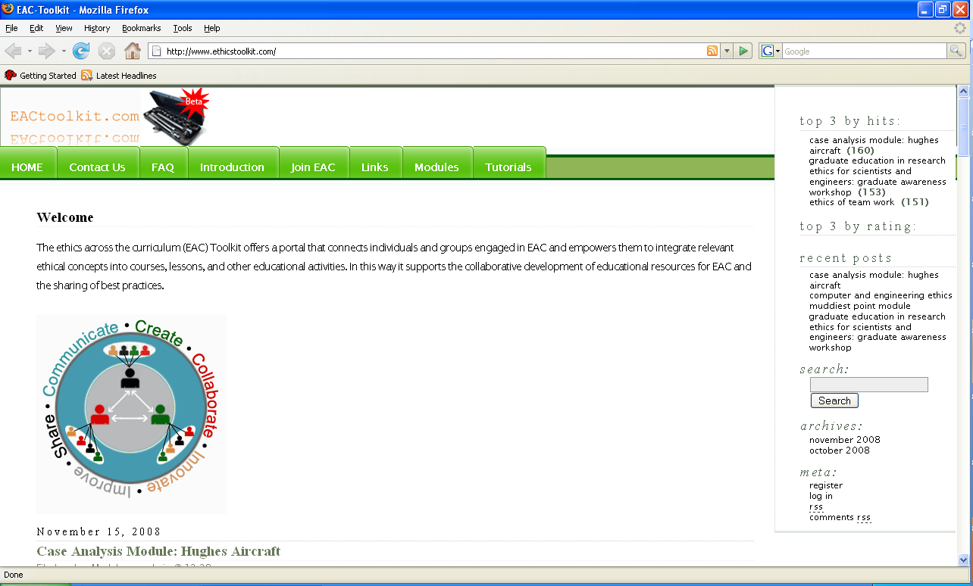
eactoolkit.com
Visit our beta website at:
http://www.eactoolkit.com

Slide 72
Appendix

Slide 73
EAC Toolkit — Demos
We will show you what we have accomplished …
Demo 1: Find a Student Module by author in Connexions®
Demo 2: View the Instructor module and our EAC Toolkit Connexions® Lens to browse a selected set of models
Demo 3: Learn how you can publish the module you have created today

Slide 74
Pedagogical Tools for Ethics
1. Cases
http://www.murdough.ttu.edu/pdd.cfm?pt=NIEE&doc=EthicsCases
http://cnx.org/content/m15991/1.6/
2. Frameworks
Ethics Tests: Reversibility, Harm, Publicity
Decision Making (7 Step)
Socio-technical system grid (see computingcases.org)
http://cnx.org/content/m13757/1.11/

Slide 75
More Pedagogical Tools
3. Codes of Ethics (NSPE, ASME, etc.)
Pirate Code of Ethics: http://cnx.org/content/m13849/1.10/
Have students write their own code. See Harold Stern’s exercise at: http://ethics.iit.edu/eac/post_workshop/CODE.doc
4. Team Work / Cooperative Learning Activities
Ethics of Team Work Module in Connexions
http://cnx.org/content/m13760/1.7/
5. Haws, David R. "Ethics Instruction in Engineering Education: A (Mini) Meta-Analysis." Journal of Engineering Education. (April 2001): 223-229.

Slide 76
More Online Sources

Slide 77
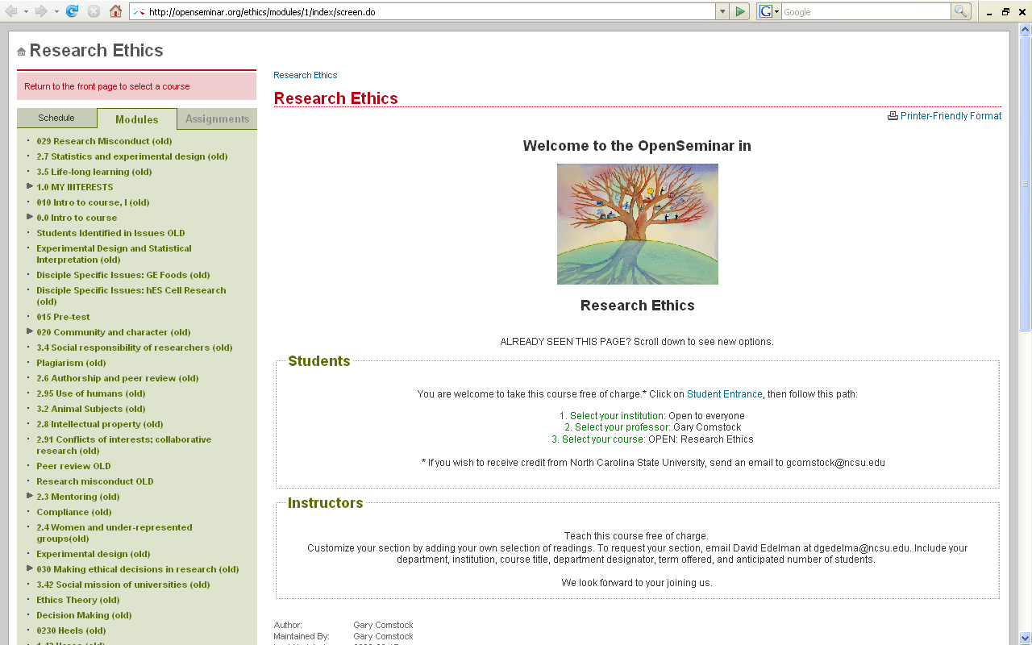
Research Ethics in Open Seminar
http://openseminar.org/ethics/modules/1/index/screen.do

Slide 78
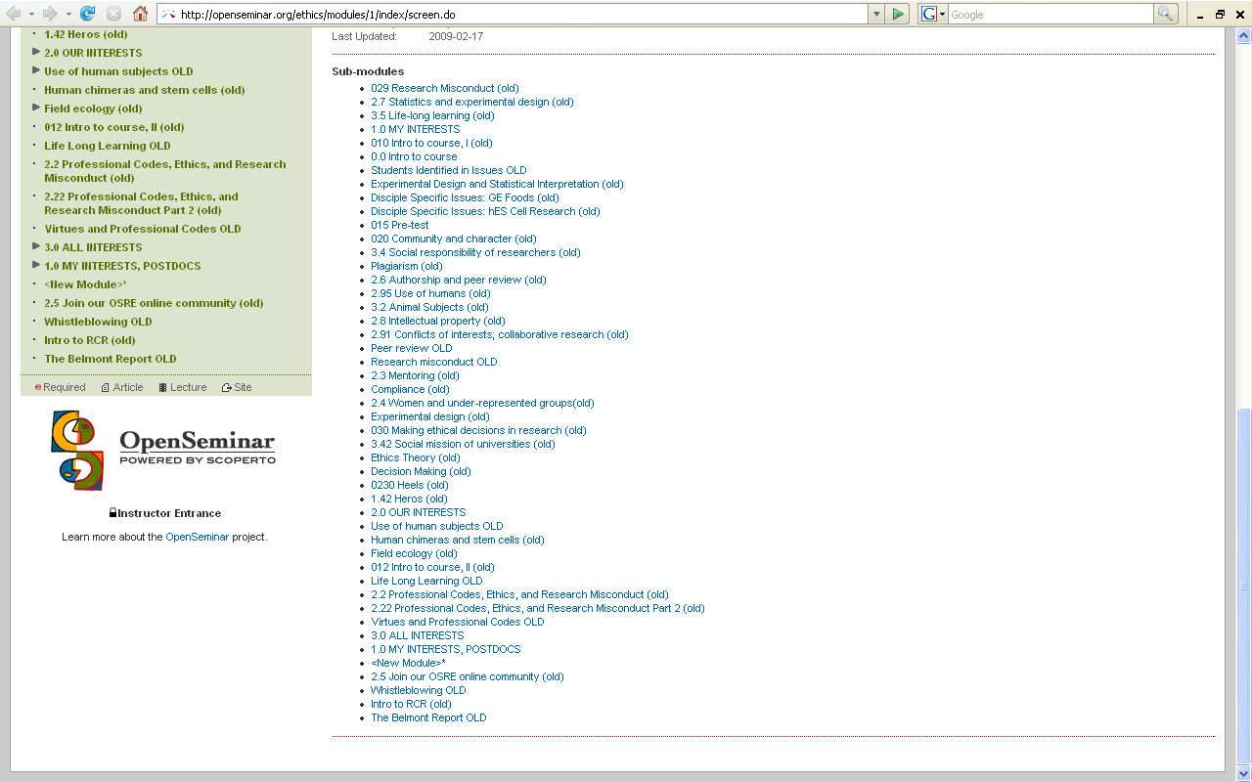
Research Ethics in Open Seminar
http://openseminar.org/ethics/modules/1/index/screen.do

Slide 79
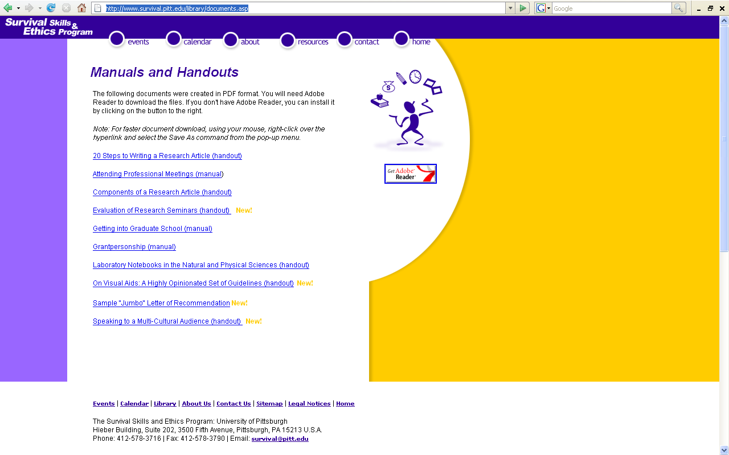
Survival Skills & Ethics Program (Pitt)
http://www.survival.pitt.edu/library/documents.asp

Slide 80
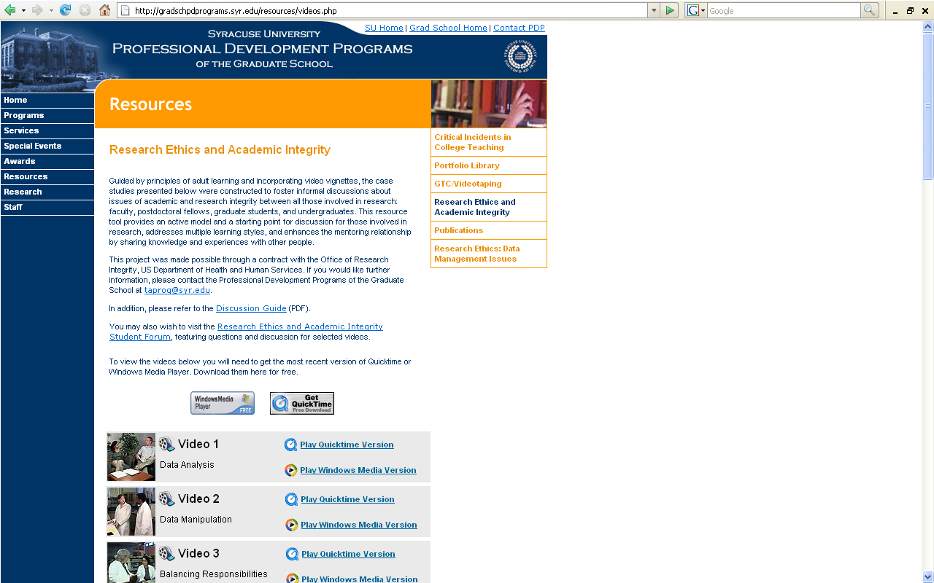
Research Ethics and Academic Integrity (Syracuse)
http://gradschpdprograms.syr.edu/resources/videos.php

Slide 81
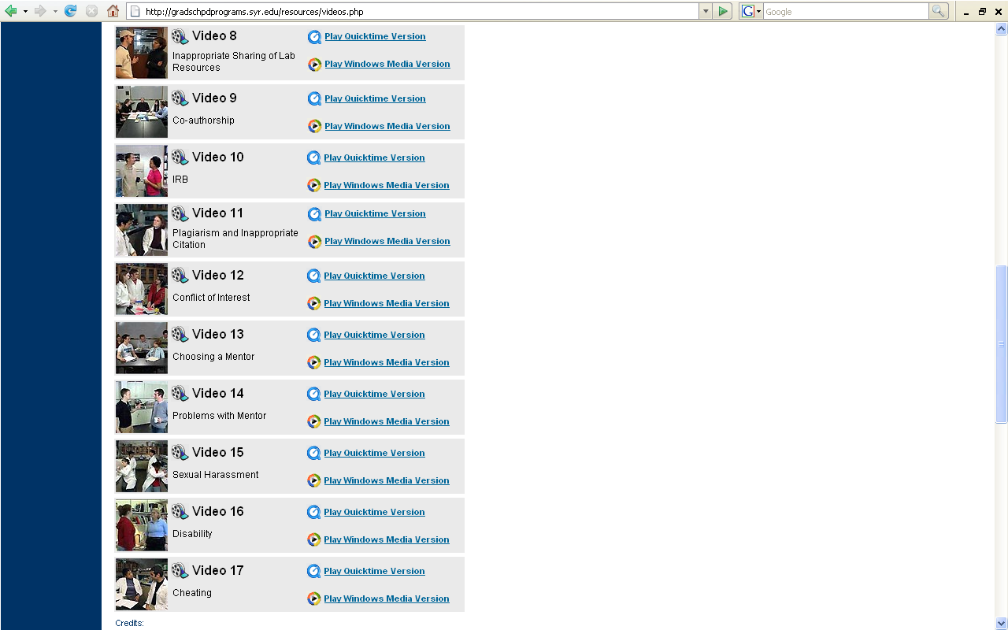
Research Ethics and Academic Integrity (Syracuse)
http://gradschpdprograms.syr.edu/resources/videos.php

Slide 82
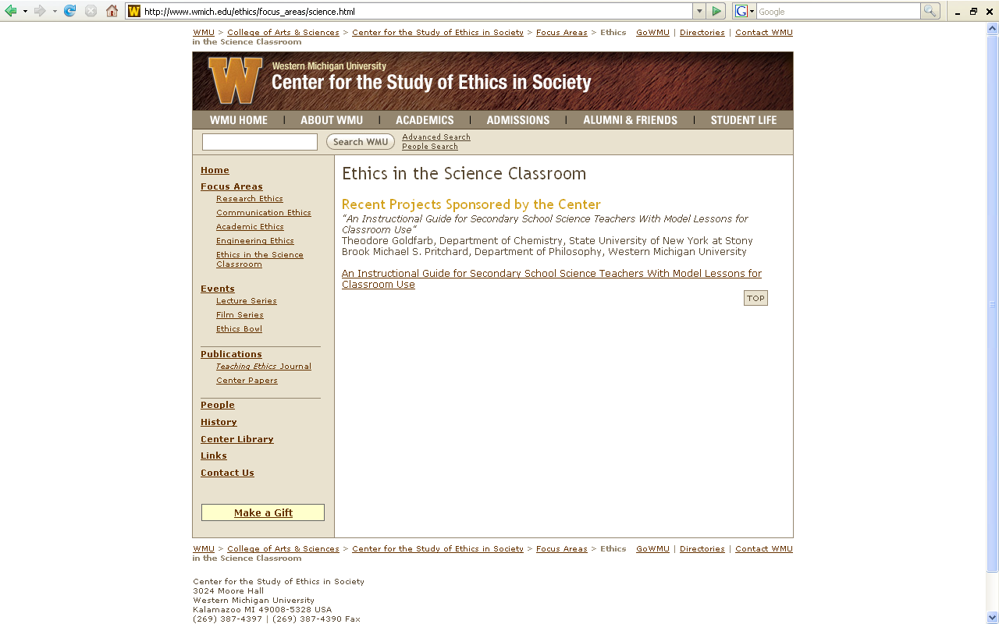
Western Michigan university
http://www.wmich.edu/ethics/focus_areas/science.html

Slide 83
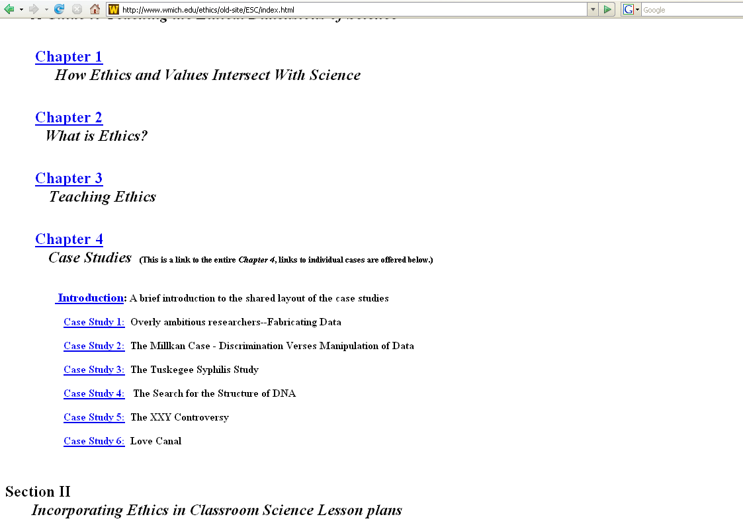
Western Michigan university
http://www.wmich.edu/ethics/old-site/ESC/index.html

Slide 84
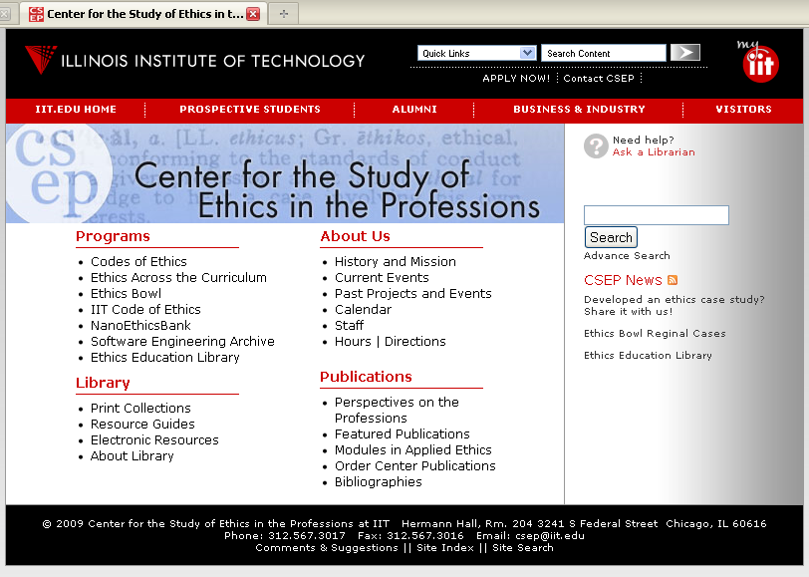
Center for the Study of Ethics in the Professions at IIT
http://ethics.iit.edu/

Slide 85
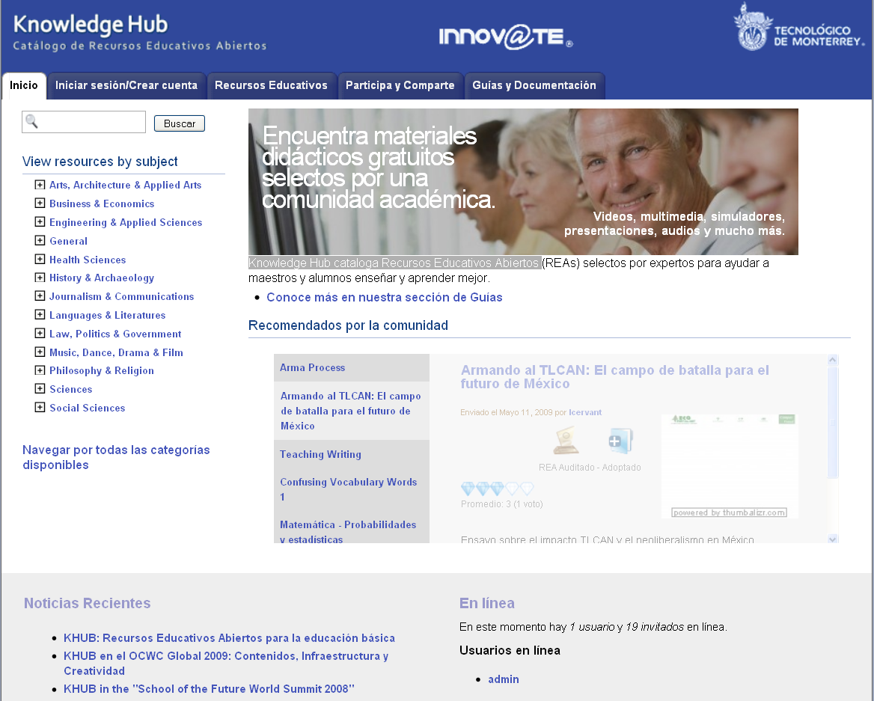
Knowledge Hub cataloga Recursos Educativos Abiertos
http://khub.itesm.mx/es/

